Slide 1

An Empirical Comparison :
The Nerd Herd
Emily, Ramatu, Evan, Melody
Classical, Bag & Boosting, and Deep Learning Models

Slide 2

Description:
Conducting a comparison of classification across different models using 3 different dataset with varying sizes and complexities to test the ‘No Free Lunch’ theorem.
Classic ML models
Bagging & Boosting Techniques
Deep Learning

Slide 3

Take-Home Message
“No Free Lunch”
No single model worked best for all datasets
Bag and Boosters: XGB > RF
Classical Models: SVM > DT
NN and SVM were too cumbersome to be practical
No single evaluation metric is appropriate across all datasets

Slide 4

Datasets
Wisconsin Breast Cancer dataset
Small, Unbalanced, Binary Classification
569 rows, 31 features, 0 nulls
Classification: Malignant (37.3%), Benign (62.7%)
Taiwan Credit Card Default dataset
Large, Unbalanced, Binary Classification
30000 row, 24 features, 0 nulls
Classification: Default (22.1%), Non-Default (77.9%)
Wheat dataset
Small, Balanced, Multiclass (3 classes)
210 row, 8 features, 0 nulls
Classification: Varieties - Kama, Rosa, Canadian (33.3%)

Slide 5

Classic Machine Learning Models: SVM
Finding the line that maximises social-distancing between the 2 classes
SVM is a classifier that finds an optimal hyperplane that maximises the distance between two classes, finding an optimal line to separate the boundary between classes.
Linear model that can classify data that is not linearly separable. It also allows additional element classification in the delineated classes.
Support vectors: a subset of the training points defined as decision boundaries. The classification decision is made based on the distances to the support vectors that were learned during the training.

Slide 6
SVM Model
F1 score: best measure of incorrectly classified cases, as it is the harmonic mean of precision and recall.
 | Accuracy | AUC-ROC | Precision (weighted Average) | Recall (weighted Average) | F1-Score (weighted Average of Precision and Recall)
Breast Cancer Dataset | 97.1 % | 99.5 % | 97 % | 97 % | 97 %
Credit Card Dataset | 82.4 % | _ | 71 % | 34 % | 46 %
Wheat Dataset | 95.2 % | _ | 96 % | 95 % | 95 %

Slide 7

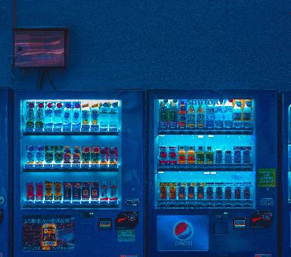


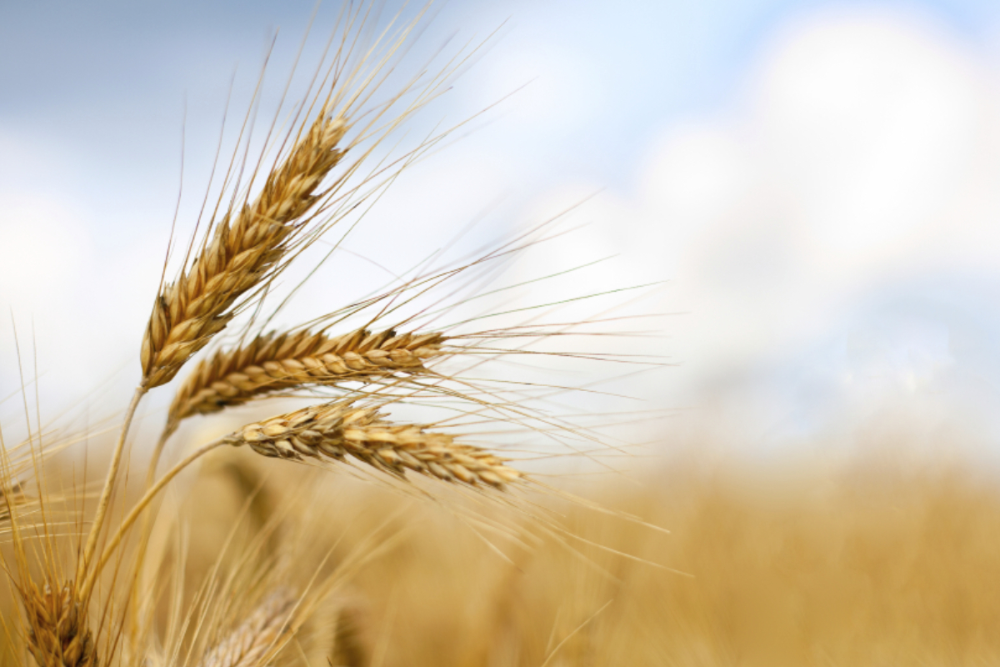

Conclusion: SVM Model
The SVM model was ranked the best on the Breast Cancer Dataset, in terms of accuracy and weighted F1 score.
Observations:
SVM is slow to train even on a small dataset.
Computationally Expensive – impractical to use.
Predicted more false negatives than false positives.
Best metric score (F1 and AUC-ROC) on the Breast cancer dataset.
Higher Precision score across all dataset – good when the goal is to limit the number of false positives.
Undesirable F1-score on credit card dataset.

Slide 8

Decision Tree Model: Baseline
Decision Tree classifier is a Non-parametric supervised learning method used for classification and regression.
The decision tree algorithm forms a node for each attribute in the dataset.
The most important attribute is placed at the root node.
The evaluation process starts at the root node and works down the tree by following a set of if-then-else decision rules
The process continues until the leaf node which contains the outcome of the decision tree is reached.

Slide 9
Decision Tree Model
 | Accuracy | AUC-ROC | Precision (weighted Average) | Recall (weighted Average) | F1-Score (weighted Average of Precision and Recall)
Breast Cancer dataset | 94.7 % | 89.8 % | 95 % | 95 % | 95 %
Credit Card Dataset | 80 % | 66 % | 62% | 27 % | 37 %
Wheat Dataset | 88.9 % | 100 % | 91 % | 89 % | 88 %

Slide 10
Conclusion: Decision Tree Model
The decision tree model performed best on the Wheat dataset, using AUC-ROC as an evaluation metric.
The train set accuracy of all 3 dataset were higher than their test set counterpart. This could be indicative of overfitting.
In the unbalanced Breast Cancer and Credit Card datasets, the tree is biased towards the dominant class (class 0).
In the balanced dataset (Wheat), the tree is equally biased towards all the classes.

Slide 11
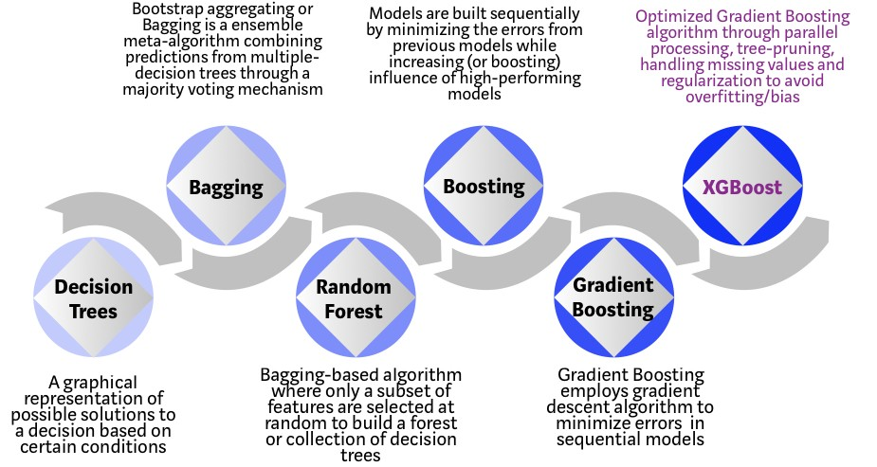

Bag to Boosting: Tree-Based
Notes:
High level overview of both:
Random forest – bagging based algo, one step below boosting in the evolution of trees.
- Take a subset of randomly selected features to build a collection of decision trees (“Forest”)
The fundamental idea behind a RF is to combine many decision trees into a single model. Individually, predictions made by decision trees (or humans) may not be accurate, but combined, the predictions will be closer to the mark on average.
by pooling predictions, we can incorporate much more knowledge than from any one individual.
Boosting – build models sequentially: boosting the influence of high-performing models and minimizing errors from previous low-performing models, using gradient descent algo
XGB avoids overfitting/bias by using regularization, parallel processing, tree pruning, and handling missing values

Slide 12
Bagger and Booster: Random Forest & XGB
Random Forrest Classifier:
- ‘Forest’ of DT’s placed into the Random Forest
- Many more trees “should be” more accurate on average due to the nature of being clumped into the same model – strength in numbers!
Extreme Gradient Boost (XGBoost):
Ensemble algorithm that uses gradient-boosted DT, designed for speed and performance
Takes a bunch of weak learners (trees), boosts influence of high performers.
Uses Gradient Descent to minimize loss with each subsequent model.
Models added sequentially until no further improvements can be made.

Slide 13
Bagging - Boosting Models
 | Accuracy | AUC-ROC | Precision (weighted Average) | Recall (weighted Average) | F1-Score (weighted Average)
Breast Cancer RF | 93.6% training set (100 %) | 92% | 95 % | 95 % | 95 %
Breast Cancer XGB | 96.5 % (100 %) | 97.9 % | 97 % | 96 % | 96 %
Credit Card RF | 74.9 % training set (88.3 %) | 65.4 % | 41% | 31 % | 36 %
Credit Card XGB | 81.6 % (85.8 %) | 75.3 % | 66 % | 35 % | 45 %
Wheat RF | 88.9 % training set (94.6 %) | 92.1 % | 89 % | 89 % | 89 %
Wheat XGB | 95.5 % (94.3 %) | 99.2 % | 80 % | 79 % | 79 %
Notes:
- XGB never took the win for any of the models, but was always a close second
-ran all our models through a pipeline to scale, find the optimal number of PCA features, fit the model, and

Slide 14
Conclusion: Bag-Boosting Models
These models were less prone to overfitting than the decision tree model. XG Boost model was less prone to classification bias than the random forest model.
The XG Boost Model performed better than RF, in terms of accuracy and minimizing errors.
The XG Boost Model is less biased towards the dominant class than the remaining tree models.
Among the tree models, XG boost gave the best results for the credit card dataset.
The ‘aggravation factor’ was low when executing the model.
RF also had a relatively low ‘aggravation factor’

Slide 15
Deep Learning
A Deep learning model is built using Artificial Neural Networks. These ANNs contains multiple layers that progressively extract higher level features from raw inputs.
First layer: Input layer.
Next: inputs are processed in the hidden layers
Output layer: an output after processing.
The patterns are not dictated by the users
NN takes in inputs in the input layer.
use weights, adjusted during training to find patterns in order to make better predictions
NN learns on its own.

Slide 16
Deep Learning Model
 | Accuracy | AUC-ROC | Precision (weighted Average) | Recall (weighted Average) | F1-Score (weighted Average)
Breast Cancer Dataset | 95. 9 % | 99.5 % | 96 % | 96 % | 96 %
Credit Card Dataset | 80.7 % | 70.8 % | 59 % | 45 % | 51 %
Wheat Dataset | 56.7% | _ | _ | _ | _

Slide 17
Conclusion: Deep Learning Model
The deep learning model performed poorly on the wheat's dataset. The model seem to perform favorably toward larger models.
The ‘aggravation factor’ was also very high across all three NN datasets, even the small ones. Training time ranged from ‘moderately annoying’ to ‘almost very certain I’ll be able to hug my friends by the time this asterisks turns into a number but I will likely throw my laptop against the wall before then’.

Slide 18

CONCLUSIONS
Best Model – Breast Cancer Dataset
We chose the best model based on the F1-score weighted average
want to limit the number of false positives and false negatives:
Weighted F1 score:
SVM – 97 % (Best Model)
XG Boost – 96 %
Deep Learning – 96 %
Decision Tree – 95 %
Random Forrest – 95 %
All models had great performance on this dataset.

Slide 19
Best Model – Credit Card Dataset
Based on the F1-score of the default (1) class.
only care about a model that can tell us if a customer is likely to default on a payment in the next month.
F1 score of default class:
Deep Learning – 51 % (Best Model)
SVM – 46 %
XG Boost – 45 %
Decision Tree – 37 %
Random Forrest – 36 %

Slide 20
Best Model – Wheat Dataset
Based on the AUC-score.
We want a model that is equally good at predicting all 3 classes.
Mean AUC-ROC score:
Decision Tree – 100 % (Best Model)
XG Boost – 99.2 %
SVM – 95 %
Random Forrest – 92.1 %
Deep Learning – unknown

Slide 21
Project Conclusions:
No Free Lunch:
Qualitative Factors to Consider
No single model performed best across all 3 datasets
A different model had best performance for each dataset
We found it was not appropriate to use the same evaluation metric across all 3 datasets, as each one had a different goal.
E.g. for a healthcare test, we care more about minimizing false negatives and false positives
Whereas, credit card default, we care more about correctly predicting who is likely to fall into the POSITIVE class
Bag-Boosters: XGB > RF
Classical Models: SVM > DT
Training time is a pragmatic consideration when choosing a model
If your laptop catches fire every time you run a model, as a practical matter, you will not use that model
XGB, RF, and DT had low ‘aggravation factor’
SVM and NN were very slow

Slide 22
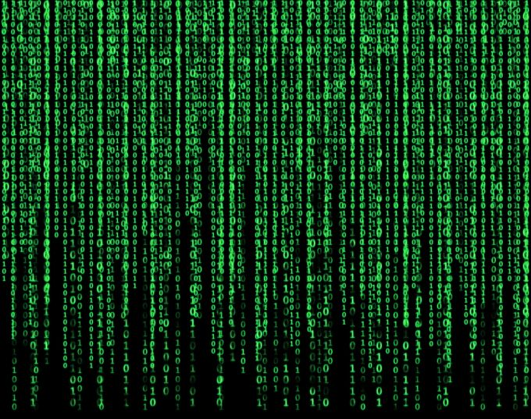


Thank You …Questions?...
April Hansson
+1 23 987 6554

